Slide 1
III. PDE
Classification of PDE
Preliminary & adjoint partial differential operators
Green’s functions & integral representation
  Free space Green’s functions
  Method of images
  Integral representation
Other methods of solution
Maximum-minimum principle of heat equation
Uniqueness proof (Laplace, Poisson and heat eq.)…
Wave equations
(2nd order)
linear, nonlinear
12/06
12/10
12/13
12/17
linear
2-3 independent variables
12/20
12/24
12/27a
12/27
12/21a
01/05
12/28
Notes:
PDE– equations involve partial derivatives of unknown functions

Slide 2
1.1 Linear & nonlinear 2nd order PDE
，
or
(subscript comma implies derivative)
linear PDE:
where
, and
quasi-linear PDE:
(nonlinear)
a, b, c, …, g, h are functions of x & y only.
where a, b, c, d are functions of
(i.e., coefficients of highest order terms can be functions of independent variables, and lower order derivatives)
semi-linear PDE:
(nonlinear)
where a, b, c are functions of x & y only, but
(fully) nonlinear PDE:
(i.e., coefficients of highest order terms can be functions of independent variables only, at most)
(other than linear, semi-linear or quasi-linear)
(could be nonlinear)

Slide 3
1.2 Types of PDE: 2nd order PDE in 2 independent variables
Consider
--- (1)
How??
Reasons to study classification:
  Solutions are different fundamentally for different types of equations.
  Only some classes of problems (IVP, BVP, IBVP) are likely to have solution or to be well-posed, depending on types of PDEs.
  Help to reduce PDEs into canonical forms, which are more convenient to find solutions.
Introduce new independent variables
φ (x,y) & ψ (x,y)
i.e. treat u(x,y) as u(φ ,ψ) = u(φ (x,y),ψ (x,y))
Proper choices of φ and ψ may make PDE simpler.
But now u=u(φ ,ψ), what is u,_{x}?
From chain rule

Slide 4
1.2 Types of PDE (2)
--- (c)
Types of PDE depend on making A, B, C = 0.
what choices of φ, ψ can make A, B or C = 0?
from (a)-(c), consider
eq. (1) in p.3 can then be written as
--- (1)
(lower order derivatives)
where
λ₁ & λ₂ : (1) distinct real roots,
(2) complex conjugate roots, or
(3) repeated real root
--- (a)
recall, from chain rule
--- (b)

Slide 5
1.2.1 b²−ac >0: Hyperbolic type PDE & characteristics
(1) two distinct real roots λ₁ & λ₂ (i.e. b²−ac>0)
What are φ & ψ ?
(φ & ψ are called characteristics of PDE)
→ take φ & ψ, such that
Since along the lines of
,
--- (1)
(from eq. (b) & (c) in p.4)
(from eq. (1))
PDE
(i.e. (1) in p.4)
, or
--- (2)
(canonical form)
solve
Furthermore,
let
lead to eqns. for
Similarly, solve
eqns. for
eq. (2)
(canonical form)
--- (3)
e.g. wave eq.:
2 sets of characteristics
(for b²−ac>0)
recall
let λ₁ and λ₂ be two roots

Slide 6
1.2 Example -- 1
Ex. consider
Ex.
--- wave equation
where a, b, c are constants with
has two distinct real roots
Let
,
--- (1)
let
solutions of (1) are
,
equation for characteristics are
--- (2)
(since λ₁ & λ₂ are constants)
--- eqns. for characteristics
i.e.
,
or take
,
from (3) & (4)
by chain rule of differentiation, PDE becomes
--- (3)
D’Alembert’s solution of standard wave eq.
the general solution of this canonical PDE is
types of PDE depend only on coefficients of highest order of derivatives in PDE.
--- (4)

Slide 7
1.2.2 b²−ac < 0: Elliptic type PDE
(2) complex conjugate roots λ₁ & λ₂
(i.e. b²−ac<0)
(canonical form)
still
PDE
, or
e.g. Laplace eq.:
but φ and ψ are complex conjugate, so
since φ (x,y) & ψ (x,y) are complex
let
no characteristics in xy plane
i.e. μ & ν are real & imaginary parts of φ & ψ
( can not have φ(x,y)=const. in real xy plane)
Large variation in solutions for small variation in IC when n is large
ill-posed problem

Slide 8
1.2.3 b²−ac = 0: Parabolic type PDE
(3) a repeated real root λ₁ (i.e. b²−ac=0)
knowing that for conic sections:
hyperbola 雙曲線
take φ such that
ellipse 橢圓
parabola 拋物線
(not only A=0, why?)
PDE
= lower order terms
Recall:
(canonical form)
for types of PDE, consider
e.g. heat eq.:
introduce new independent variables
only 1 set of characteristics, determined by
where
recall: conic sections（圓錐曲線）

Slide 9
1.2 Remarks
Classification of PDE is only a local property of the equation!
Change variables does NOT alter the type of PDE!!
Consider PDE as
Ex. Consider the Tricomi eq.
Types of PDE depend on the sign or zero of
Let φ & ψ be any choices of two new independent variables, φ=φ(x,y), ψ=ψ(x,y)
After change of variables, one has
b²−ac < 0
elliptic
Q: What happens on type of new PDE by
considering B² − AC??
parabolic
b²−ac > 0
hyperbolic
(≠0, why?)
hence, (B² − AC) and (b² − ac) have the same sign,
or zero!!

Slide 10
1.3 Remarks – PDE with more than 2 independent variables
Consider 2nd order PDEs in more than 2 independent variables
There are still some PDEs belong to hyperbolic, parabolic, elliptic type of PDEs as:
hyperbolic type PDE
lower order terms
parabolic type PDE
lower order terms
elliptic type PDE
lower order terms
but Some PDEs may not belong to any of these three catalogs!

Slide 11
2.1 Preliminary
divergence theorem
(Gauss’ theorem)
D: domain
∂D: boundary of domain D
n: unit outward normal
in eqns. dS: infinitesimal surface area element
→ positive scalar, no issue on direction of path
Green’s 1st identity
If D is 2D domain, then ∂D is a curve
since
then dS: infinitesimal arc length element
→ positive scalar, no issue on direction of path
Green’s 2nd identity
(cf. integration by parts in 1D integration)
since
special case: for
--- Green’s theorem
(or take in Gauss’ th.)
Notes:
definition of D, partial D, n
1st identity acts as integration by parts in mutli-dimensional cases
2nd identity will serves like \int{v L u – u L* v} dx = ……

Slide 12
Remarks
no issue on direction of path
directional derivative
surface integral in 2D
B
Consider u(x, y)
consider
: rate of change of u in the x direction
along OA
: rate of change of u in the y direction
(O→A):
O
A
along AB
Q: What is the rate of change of
u in a given direction τ ?
(A→B):
similarly, (B→A)
(τ: unit vector)
OK!
normal derivative: rate of change along the
outward normal direction n
(
)
along BO
(B→O):
unit outward normal vector
OK!
or, (O→B):

Slide 13
2.2 Adjoint partial differential operator
Denote partial differential operator L of order p in n variables as
such that
--- (3)
--- (1)
If L= L*,
then L is formally self-adjoint
where
, e.g.
e.g. const. coeff. + only even order derivatives
e.g. for 2nd order linear partial differential operator in 2 independent variables
How to find J ?
(integration by parts as ODE?)
cf. ODE (p.2-108)
--- (a)
adjoint differential
operator for ODE
--- (b)
Then, the adjoint operator is
--- (2)
--- (c)
Notes:
k 為一堆有順序排列的數目字 |k| 為這些數目字的和
與 常微分運算子的情況十分相像
偶次階微分不會變號 → 常係數、且為偶次階微分必為 formally self-adjoint
Laplacian operator is formally self-adjoint

Slide 14
2.2 Adjoint 2nd order linear partial differential operator
Consider a general 2nd order linear PDE in 2 independent variables
where
Recall, 1 D integration by parts
(why?)
or
Compare L & L*
→ If a, b, c are constants and e = f = 0, then L=L*.
since
Since
□,_{x}+○,_{y}=▽ (□ i+○ j)
from divergence theorem
J = □ i+○ j
i.e. try to move all the differentiation away from u, and make other intermediate terms as
□,_{x} + ○,_{y}
recall
divergence theorem
Notes:
k 為一堆有順序排列的數目字 |k| 為這些數目字的和
與 常微分運算子的情況十分相像
偶次階微分不會變號 → 常係數、且為偶次階微分必為 formally self-adjoint
Laplacian operator is formally self-adjoint

Slide 15
2.2.1 Laplacian Operator
In 2 dimensions:
In general, multi-dimensional:
-- formally self-adjoint differential operator
-- formally self-adjoint differential operator
consider
Q: What is J for multi-dimension?
directly from Green’s 2nd identity!!
since
□,_{x}+○,_{y}=▽ (□ i+○ j)
if
= □,_{x}+○,_{y}
J = □ i+○ j
recall

Slide 16
2.2.2 Heat Operator – with one space dimension
one (space) dimensional heat eq.
Since in (x, t) domain is
,
-- not formally self-adjoint
→ PDE in 2 independent variables (x,t)
i.e.
Consider a space-time domain , in (x,t) space with outer normal
recall

Slide 17
2.2.2 Heat Operator – multi space dimension
multi-dimensional heat operator
PDE in space-time domain
where
: gradient operator in space-time domain
i.e.
initial condition → terminal condition
recall

Slide 18
2.2.3 Wave Operator
one (space) dimensional wave eq.
,
-- formally self-adjoint
PDE in 2 independent variables (x,t)
Consider a space-time domain , in (x,t) space with outer normal
i.e.
initial cond. → terminal cond.
□,_{x}+○,_{t}= (□ e_{x}+○ e_{t})

Slide 19
2.3 Remarks – 1- BCs (in spatial variables)
e.g. Laplace equation
Green’s function prob. is self-adjoint
or Poisson equation
(nonhomogenous Laplace eq.)
there are 3 different types of boundary conditions:
Dirichlet BC (Dirichlet problem; 1st BVP)
Neumann BC (Neumann problem; 2nd BVP)
Robin BC (Robin problem; 3rd BVP)
recall

Slide 20
2.3 Remarks – solvability condition for Poisson eq. with Neumann BCs
Consider Poisson equation with Neumann BC
←→ (Fredholm) alternative theorem
in BVP with ODE
physical meaning
---- DE
(Poisson equation )
(Neumann BC )
How about use L and L* as in ODE
---- BC
from Green’s theorem
(cf. ←→ p.2-124 & 125)
If there is a solution u of the problem, i.e. there is a u satisfies DE in D and BC on ∂D
(condition to have solution u,
--- solvability condition)

Slide 21
Review: Dirac delta function in multi-dimension
intuitive definition of δ (x) in 2 or 3-dimension:
intuitive definition of δ (x) in 1-dimension:
Dirac delta function in Cartesian coordinate system:
since
It will be slightly different in other coordinate system.

Slide 22
3.1 Free-space Green’s functions – Introduction
Free-space Green’s function also called as
-- Green’s functions of unbounded region
-- fundamental solutions
-- particular solution of DE
e.g. for 2D & 3D Laplace equation
,
Introduce new coordinate system, with origin at x₀, then
3D:
2D:
,
,
(polar symmetry)
(spherical symmetry)

Slide 23
3.2.1 Free-space Green’s function – 2D Laplace
Consider 2D Laplace equation
cf. Green’s function with ODE, e.g.
let
ODE
PDE
(polar symm.)
integrating both two sides of PDE
by BC
(by Green’s theorem, and n=e_{r})
Continuity cond.:
Jump cond.:
Jump cond.:
(take B=0)
……
looking for only solution of DE but not with BC
→ particular sol.
, singular sol.
Green’s theorem

Slide 24
3.2.1 Free-space Green’s function – 3D Laplace
3D Laplace equation
let
PDE
or
(spherical symmetry)
integrating both two sides of PDE (using Green’s theorem)
(n=e_{R})
(take B=0)
Green’s theorem
Notes:
phi: zenith angle 天頂角 (or polar angle)
theta: azimuth angle 方位角

Slide 25
3.2 Review – Equi-dimensional ODE
equi-dimensional ODE (Euler equation)
recall in p.24
(every term in ODE has the same dimension)
recall in p.23 (see also p.21)
--- (2)
--- (1)
let
substitute into ODE (2)
let
(why?)
substitute into ODE (1)
(double roots)
OK!!
OK!!

Slide 26
3.2.2 Free-space Green’s function – heat eq.-1
1D heat equation, infinite length
i.e.
(integration by parts)
(BC)
(IC)
method 1: Laplace transform pair over t
(transformed BC) no IC
using BC + continuity & jump cond.
,
Br: Bromwich path
then from table of Laplace transform, one has
Apply Laplace transform to the problem
Notes:
Fourier transform over x, or Laplace transform over t

Slide 27
3.2.2 Free-space Green’s function – heat eq.-2
1D heat equation, infinite length
PDE →
(transformed IC)
no BC (why?)
(BC)
(IC)
using IC
+ jump cond., but no continuity condition
method 2: Fourier transform pair over x
then from table of Fourier transform, one has
Apply Fourier transform to the problem

Slide 28
3.2 Remarks – Free space Green’s function of heat eq.
recall, for 1D heat equation, infinite length
now, consider (source at x=x₀, t=t₀)
(source at x=0, t=0)
(IC)
(BC)
(BC)
the solution is
(IC)
From p. 26 & 27, the solution is
physical interpretation ??
why??
How about higher dimension
-- can not be reasonable rigorously, but it
is still a very good approximation
(mathematically: constant coefficients DE
physically: homogeneous medium)

Slide 29
3.3 Method of images – 1 (Introduction)
Green’s functions in bounded regions with Dirichlet/Neumann BCs, e.g.
as if in unbounded region
corrections to satisfy BC;
outside domain D
(satisfy PDE automatically)
Basic idea: Superimpose several free space Green functions with suitable choices of strengths and locations of singular points together with any homogeneous solution of PDE, so that the specified BC’s are satisfied.
In general,
recent development:
Method of fundamental solutions
(numerical method)
Notes:
satisfy PDE, then to satisfy BCs

Slide 30
3.3.1 Method of images – half plane -1
(BC)
(BC)
by method of images, consider
how about Neumann BC?
how about 3D problems?
(see p.31)
(both Dirichlet/Neumann BCs)
BC along x=0:
OK!!
recall
2D free-space Green’s function
check BC at infinity:
OK!!
r : distance between source &
receiver

Slide 31
3.3.1 Method of images – half plane -2
(BC)
(BC)
by method of images, consider
Plane boundary
(homogeneous) Dirichlet BC
→ skew-symmetric problem
→ G: odd function
→ G = 0 along line of skew-symmetry
(homogeneous) Neumann BC
→ symmetric problem
→ G: even function
→ normal derivative = 0 along line of symmetry
BC along x=0:
OK!!
check BC at infinity
no way to satisfy BC at infinity,
(physically impossible: steady state temperature distrib.)
unless BC is

Slide 32
3.3.2 Method of images – quarter plane
(BC)
(BC)
(BC)
by method of images, consider
how about Dirichlet BCs?
how about Neumann BCs?
how about other wedge shape?
(only if wedge angle=2π/n, n: positive integer)
how about 3D ?
(i.e. skew-symmetric w.r.t. y=0, symmetric w.r.t. x=0)
BC along x=0 & y=0:
OK!!
check BC at infinity: OK
Notes:
If this is only a Neumann problem, will there be any trouble?
Since by using of method of images, it will be a sum of two free-space Green’s function solutions, but then will it satisfy the condition at infinity?

Slide 33
3.3.3 Method of images – circle
By method of images,
consider
--- (1)
(constant is homogenous sol. of PDE)
where image point , is defined such that
, and
--- (2)
(x_{s}: boundary points)
re-write (2) as
From similar triangles
from BC
recall
(Does c depend on x_{s}?
can c be a constant?)
(constant!!)

Slide 34
3.3 Remarks -- Method of images for circle/sphere
using method of images for
solution in 3D (sphere)??
hollow region
Neumann BC in 2D (circle) ??
3D Neumann problem??
Method of images can handle ONLY problems with very simple geometries,
e.g. plane, line, circle, sphere boundaries.

Slide 35
3.3.4 Method of images – heat eq. (semi-infinite)
(IC)
(BC1)
(BC2)
For Neumann BC at , i.e.
By method of images,
(BC1)
( Dirichlet BC)
check BC at infinity: OK
check BC at infinity: OK
where
(see p.26-28, for free space Green’s function G₀)

Slide 36
3.3.4 Method of images – heat eq. (finite length)
+
By method of images, consider
how about Neumann BCs at both two ends?
how about Dirichlet/Neumann BC at each end, separately?

Slide 37
3.4 Integral representation for bounded region – Laplace eq. + Dirichlet
Once having Green’s function, still need to express u in terms of G
consider Laplace / Poisson equations
---(1)
Since
(self-adjoint prob.)
associated Green’s function prob.
hence, if G can be found then
---(2)
(homogeneous data)
Unfortunately, sometimes finding G is almost impossible for PDE (especially for irregular bounded region)!!
by using Green’s 2nd identity
Green’s 2nd identity

Slide 38
3.4 Integral representation for bounded region– Laplace eq. + Neumann
Laplace / Poisson equations
---(1)
associated Green’s function prob.
(if G can be found)
---(2)
But, in fact, non-trivial homogeneous solutions exist for bounded region with Neumann BCs!!
(homogeneous)
→ Associated Green’s function does not exist!!
→ need modified Green’s function or other
approaches
by using Green’s 2nd identity
Green’s 2nd identity

Slide 39
3.4.1 Remarks: Integral representation – Laplace eq.
Consider Laplace / Poisson equations
with Dirichlet BC
(especially for irregular region D)
Ex.
---(1)
---(4)
eq. (4) is an integral equation for boundary values of normal derivatives of u(x)
→ boundary element method (BEM)
Once eq. (4) having solved for u & ∂u/∂n on boundary numerically, eq. (4) can be employed again to evaluate u(x) in D.
associated Green’s function problem
---(2)
leads to boundary integral equation (solved numerically)!!
If G is not available
use free space Green’s function G₀ directly, instead of G!!
---(3)

Slide 40
3.4.1 Example – Laplace eq. in a disk (Dirichlet BC)
Ex. 1: Consider a (2D) problem in a disk as
---(1)
[sol:] associate Green’s function problem
From p.33 (i.e. Green’s function for a circle)
---(2)
from p.37 or by
(cosine
law)

Slide 41

3.4.1 Example – Laplace eq. in a disk (cont.1)
P
4.physically
and/or mathematically to both sides:
(domain average)
--- Poisson’s formula
Can also be obtained by separation of variables or method of complex variable
at r = 0,
from
p.42
where
(boundary average)

Slide 42
3.4.1 Remarks –Some theorems for Laplace eq.
Mean-value theorem for Laplace equations
Uniqueness proof for Dirichlet problem
(with Laplace or Poisson PDE)
The mean of the values of a harmonic function (i.e. satisfying Laplace equation) over a circle (2D) or a sphere (3D) surrounding a given point P is equal to the function value evaluated at point P.
consider both u₁ & u₂ satisfying
P
let
, then w satisfies
Max-Min principle for Laplace equations
A harmonic function can not have its max. or min. within a bounded region D, unless it is a constant everywhere.
from Max-Min principle of Laplace equation
Hence Laplace / Poisson PDE, with Dirichlet BCs
in bounded region, always has unique solution.
D can be an arbitrarily bounded region
D
Notes:
反證法—proof by contradiction

Slide 43
3.4.2 Integral representation – heat eq.
Consider a IBVP for heat eq.
Adjoint Green’s function problem
(PDE)
(BC)
(BC)
(IC)
(terminal condition)
associated Green’s function problem
from
(BC)
Moreover, by considering u & G*
(IC)
from p.17

Slide 44
3.4.2 Example – 2 (heat eq. with nonhomogeneous IC)
Consider
where
(from p.28)
from p.43
can also be found by other methods directly, e.g., Laplace transform over t or Fourier transform over x.
note that
initial conditions:
??
not easy to verify, unless…..

Slide 45
4. Other methods of solution
Other methods of solution:
separation of variables
(full) eigenfunction expansion
partial eigenfunction expansion
Fourier (or Laplace) transforms
X
O
O
O

Slide 46
Review: Separation of variables --1
(1. idea of separation of
variables)
(substitute into PDE)
(2. functions of x & y,
separately)
3. eigenvalue problem
(solve this BVP first,
by considering λ >0,
=0, <0, separately)
(4. result of eigenvalues, λ ,
from problem of X has
been used)
,
(eigenfunctions)
(eigenvalues)
(5. linear combination of all possible X & Y)
by orthogonality of eigenfunctions,
coefficients A_{n} can be found from BC at y = 0
BVP is now solved.

Slide 47
Review: Separation of variables --2
Key factors for applying method of separation of variables:
PDE itself is separable.
(e.g. homogeneous, “no cross-differentiation”)
e.g.
counterexample:
e.g.
due to cross
differentiation term
due to
nonhomogeneous term
PDE with cross-differentiation term, but is still separable.

Slide 48
Review: Separation of variables --3
A pair of homogeneous BC
Shape of boundary
(to form an eigenvalue prob.)
(along lines of constant coordinates)
??
→can be handled by rotating coordinate axes
+
=
possible boundary shapes are
rectangle, circle, ellipse, ….
box, circular cylinder, sphere, ….

Slide 49
4.1 Eigenfunction expansion -- 1
Recall
Associated eigenvalue problem for Laplace (Poisson) equations
regular Sturm-Liouville eigenvalue problem for ODE
(i.e. take ρ=1, why?)
All eigenvalues are real;
there exists a countable set of eigenvalues, which form a increasing sequence:
infinite number of eigenvalues, and as
;
there may be several linearly independent eigenfunctions corresponding to the same eigenvalue (i.e. eigenvalues may not be simple)
real, simple, countable
(matrix theory)

Slide 50
4.1 Eigenfunction expansion -- 2
Eigenfunctions corresponding to different eigenvalues are orthogonal over domain D, i.e.
In ODE, eigenfunctions are orthogonal with respect to weighting function ρ (x) in [a, b]. Thus, if eigenfunctions φ_{i}(x) & φ_{j}(x) correspond to different eigenvalue λ_{i} & λ_{j}, then
(ρ=1)
if
Moreover, different eigenfunctions corresponding to same eigenvalue can be made orthogonal
if
(←→ matrix theory)
Eigenfunctions form a complete set in [a, b], then any piecewise smooth function u (x) can be expressed as
Eigenfunctions {φ_{λ}(x,y)}form a complete set in D, any piecewise smooth function u (x, y) can be expressed as
The series converges in the mean.
The series converges in the mean.

Slide 51
4.1 Example 1 -- Eigenvalues & Eigenfunctions for Laplace/Poisson eq.
after finding values of α, we can then solve this Y problem
by separation of variables,
,
a. eigenvalues λ_{km} are real.
b.
c. different eigenfunctions may correspond to same
eigenvalue, e.g., if L=2H,
How about with Neumann boundary conditions at x direction?
How about with Neumann boundary conditions at both x & y directions?
as
Both prob. of X & Y are eigenvalue prob., can solve either one first. Let’s solve X first.
,
,
Consider cases of
,
,

Slide 52
4.1 Example 2 -- Eigenfunction expansion (homogeneous BC)
Ex.
y
(1,1)
(0,1)
associated eigenvalue problem
x
(1,0)
(term by term
differentiation, ok!!)
by using separation of variables (as in p.51)
by orthogonality of eigenfunctions, we have
by eigenfunction expansion
λ_{km} ≠ 0 ? (see p.42)
how about expand f,
how about Green’s function problem
Since the series is uniformly convergent,
substituting series into PDE leads to

Slide 53
4.1 Example 3 - Green’s function by eigenfunction expansion
Ex.
y
by the approach as in p.52
x
by direct observation
this problem can also be solved by method of images.
(→ double summation over image sources)
Are these two solutions consistent?
comments on # of BCs.
(OK!! self-adjoint problem)
From p. 52
,

Slide 54
4.2 Example 4 - Eigenfunction expansion (nonhomogeneous BC)
Ex. Prob. with nonhomogeneous Dirichlet BCs
Method 1: Let
satisfies nonhomogeneous DE with
homogeneous BCs
associated eigenvalue problem
--- can be solved by eigenfunction expansion
satisfies homogeneous DE with
nonhomogeneous BCs
--- can be solved by separation of variables
using eigenfunction expansion, let
OK. (why?)
But term by term differentiation does NOT
work!! (Since the series is not uniformly convergent)

Slide 55
4.2 Example 4 (cont.1 – eigenfunction expansion)
Method 2: eigenfunction expansion directly
as usual, consider
---(1)
Associated eigenvalue problem
by using Green’s 2nd identity,
---(2)
(cf. p.2-147)
Once finding eigenvalues & eigenfunctions, then
by eigenfunction expansion, let
(the series now is only pointwisely convergent, term by term differentiation does NOT work)
What happens if λ₁₁=0?
This problem can also be solved by finite transform pairs
Only for bounded domains
on the other hand, If u is given, A_{km} is
But it will NOT be the case for Laplace eq. with Dirichlet BC

Slide 56
4.2 Example 4 (cont.2 – finite transform)
Method 3: finite integral transform
Using Green’s second identity gives
(acting as integration by parts)
from eigenfunction expansion
---(a)
If u is given, expansion coefficient A_{km} is
---(b)
(a) & (b) can be treated as finite integral transform pairs!! where
OK!!
Apply finite integral transform to PDE
(cf. p.2-149)
i.e. apply to the PDE

Slide 57
4.3 Example 5 - Partial eigenfunction expansion
y
(1,1)
Ex.
(0,1)
Method 1: full eigenfunction expansion, see p.52
(1,0)
x
eigenvalues:
eigenfunctions:
(uniformly convergent series)
---(b)
Method 2: partial eigenfunction expansion
(uniformly convergent series, why?)
But, how to find expansion coefficients A_{k}(y)?
(eigenfunction only in part of independent variables)
substitute eq. (b) into original PDE
consider eigenvalue problem in x variable
---(a)
by orthogonality of eigenfunctions
---(c)

Slide 58
4.3 Example 5 (cont.1)
possible methods to solve for A_{k}(y)
---(c)
eigenfunction expansion in y again
→ back to full eigenfunction expansion
variation of parameters
1D Green’s function in y
where
eq. (c) is 2nd order ODE, need 2 BCs of A_{k}(y)!!
[BCs u(0,y)=u(1,y)=0 have been used to find eigenfunctions in x.]
from BCs u(x,0)=u(x,1)=0
where
how about Green’s function problem? (see p.59)
y
(1,1)
(0,1)
(1,0)
x

Slide 59
4.3 Example 5 (cont.2 – Green’s function-1)
Special case:
y
(1,1)
(0,1)
partial eigenfunctions in x
x
(1,0)
from continuity condition
homogeneous solutions of DE for A(y):
jump condition

Slide 60
4.3 Example 5 (cont.3 – Green’s function -2)
(e.g. nonhomogeneous data only in one variables)
sometimes it is more flexible, e.g.
interval is not finite for some variables, see p.61 & heat eq.
more complicate PDE
Remarks on partial eigenfunction expansion:
convergence is much faster than that from full eigenfunction expansion.
might be easier to handle prob. with nonhomogeneous boundary data
from p.59

Slide 61
4.3 Example 6 – Laplace eq. (Infinite strip)
y
Ex.
(1,0)
x
(full eigenfunction expansion in x & y does NOT work! Why?)
Method 1: partial eigenfunction expansion
from BC in y, and then continuity conditions & jump conditions
find eigenfunction in x first, then
(as p.57)
let
(uniformly convergent)
substitute expansion into PDE, and use orthogonality

Slide 62
4,3 Example 6 (cont.1)
Method 2: Fourier transform over y
y
(1,0)
x
(transformed BC
no transformed BC in y, why?)
continuity condition

Slide 63
4,3 Example 6 (cont.2)
jump condition
where
,
Recall, in p.61, Green’s function was found by partial eigenfunction expansions
Obviously, these two expressions are different.
It can be shown by contour integration in complex variables that these two expression are identical.

Slide 64
4.4 Example 7 – Heat eq. (Eigenfunction expansion)
Ex. 1-D Green’s function for heat equation in a finite region
(PDE)
(BC)
(IC)
(see p. 36 by method of images)
associated eigenvalue problem in x variable
since the series is uniformly convergent, substituting the series into PDE leads to
eigenvalues:
eigenfunctions:
by orthogonality of eigenfunctions
eigenfunction expansion in x, let
IC is

Slide 65
4.4 Example 7 – Heat eq. (cont)
using IC
jump cond. (but no continuity cond.)
(good for long
time response)
2. recall, from method of images (from p. 36)
or
using IC
jump cond.
recall, from p.64
,
(good for short time response)

Slide 66
4.4 Example 7 – Heat eq. (discussion)
Recall, from p.28
Now, from p. 64
let t’=kt
from p. 2-105

Slide 67
5. Max.-Min. Principle of Heat Eq.
Consider bounded domains D (in x-space) and Q_{T} (in x-t space), as
Ex:
,
Let u(x,t) be continuous in Q_{T}+∂Q_{T} , and satisfy homogeneous heat eq. in Q_{T} , i.e.
min [along AB, AE and BF]
≦ [u(x,t) within square + EF]
≦ max [along AB, AE and BF]
Suppose also
(IC)
(BC)
the solution of Dirichlet problem
with homogeneous heat eq. is unique & well-posed
with nonhomogeneous heat eq. is unique
for some m & M,
then
Max-min principle for Laplace eq. see 3-42.

Slide 68
6.1 Uniqueness Proof -- Laplace and Poisson eq.
1.Dirichlet problem
---(1)
(from Green’s first identity)
let u₁ & u₂ be two solutions,
---(3)
let
, then w satisfies
(from BC)
solution of u is unique
---(2)
2. Neumann problem
(if w=0 in D, then solution of problem of u is unique!!)
(from (3) & BC)
Method 1: By max-min principle
(may not be zero)
(see p.42, only for Dirichlet prob.)
Solution of u is unique up to a const.
Method 2: consider
(solvability cond. see p. 20)
3. How about Robin problem ??

Slide 69
6.2 Uniqueness Proof -- Heat equations -1
1.Dirichlet problem
---(1)
let u₁ & u₂ be two solutions, and
let
, then w satisfies
and
---(2)
solution of u is unique
2. Neumann problem
Method 1: By max-min principle (p.68)
(only for Dirichlet prob.)
3. How about Robin problem ??
Method 2: consider

Slide 70
6.2 Uniqueness Proof -- Heat equations -2
Method 3: consider
e.g.
---(a)
continuous, differentiable and non-negative,
e.g.
But from IC
---(c)
from (a), (b) & (c)
Since I(t) is differentiable, let us consider dI/dt
, ∀ x & t
(heat eq.)
solution of u is unique
---(b)
(Green’s 1st identity)
I is a non-increasing function of t

Slide 72
7. Wave equations
hyperbolic PDE
interpretation of f (x−ct)
D’Alembert’s solution – general sol. of wave eq.
at time t = 0 :
f (x)
: distribution of displacement along the length.
at t = t₁, f (x – ct₁)
: another distribution of displacement.
a disturbance propagates to the direction of + x-axis with finite speed c
the shape of the disturbance remains unchanged.
(No dispersion!!)
Notes:
In the x, t (space, time) plane, g(x −ct) is constant along the straight line x − ct = constant. Thus to the observer (x, t) who moves at the steady speed c along the positive x-axis., the function g is stationary. Thus to an observer moving from left to right at the speed c, the signal described initially by g(x) at t = 0 remains unchanged in form as t increases, i.e., g propagates to the right at the speed c.

Slide 73
7.1 D’Alembert’s solution: infinite region -- 1
x
--- IC
--- IC
---(3)
from (1) & (3)
From D’Alembert’s sol.
(general solution of PDE)
---(1)
IC
---(2)
(derivative w.r.t argument)
from (2)
Notes:
where h(x) and v(x) are non-zero only in the finite domain of x (i.e. have compact support).
In wave equation the highest time derivative is of the second order and initial data are prescribed for u and ∂u/∂t. Initial conditions that specify all derivatives of all orders less than the highest in the differential equation are called the Cauchy initial conditions.

Slide 74
7.1 D’Alembert’s solution: infinite region -- 2
Example:
IC
characteristics
u (x,t)
x
x
x
x
x
− a
a
The initial disturbance h (x) is split into two equal parts propagating in opposite directions with constant speed c
Notes:
The initial disturbance h (x) is split into two equal parts propagating in opposite directions with constant speed c. The outgoing waves preserve the initial profile, although their amplitudes are reduced by half.

Slide 75
7.1 D’Alembert’s solution -- Remarks (1)
range of influence & domain of dependence
range of
influence
ct
domain of
dependence
x
p
q
signal takes time to reach another point!! (wave!)
finite signal speed!
in inhomogeneous medium and/or nonlinear wave theory, characteristics may no longer be straight lines!!
x
Notes:
domain 定義域； range 值域
To see the physical meaning, let us draw in the space-time diagram a triangle formed by two characteristic lines passing through the observer at x, t, as shown in the Figure. The base of the triangle along the initial axis t = 0 begins at x − ct and ends at x + ct. The solution depends on the initial displacement at just the two corners x − ct and x + ct, and on the initial velocity only along the segment from x − ct to x + ct. Nothing outside the triangle matters. Therefore, to the observer at x, t, the domain of dependence is the base of the characteristic triangle formed by two characteristics passing through x, t.
On the other hand, the data at any point x on the initial line t = 0 must influence all observers in the wedge formed by two characteristics drawn from x, 0 into the region of t > 0; this characteristic wedge is called the range of influence.

Slide 76
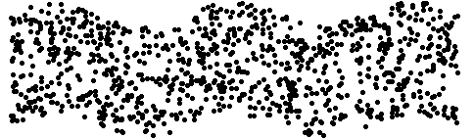
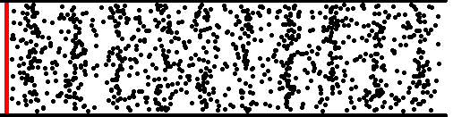
7.1 D’Alembert’s solution -- Remarks (3)
transverse wave (橫波). : displacement is perpendicular to the direction of the wave
longitudinal wave (縱波): displacement is parallel to the direction of the wave.
Particles do not move along with waves; they simply oscillate.

Slide 77
7.2 semi-infinite region: D’Alembert’s solution --1
(a) fixed end, with
x
x > 0
(fixed end)
IC
,
by BC
BC
,
t > 0
: odd function
??
as in p. 76
(h(x) is a given function)
(only for x>0)
Define
IC
for x − ct > 0
( x > ct )
for x − ct < 0
( x < ct )
same solution as infinite rod??
any contribution from BC??
(check BC at x=0, )
OK!!
But…??
Notes:
Let us use the d’Alembert solution to a problem in a half infinite domain x > 0. Consider a long rod from x = 0 to infinity. How do disturbances generated near the left end propagate as the result of initial displacement and velocity?
For the case of fixed end, At the left boundary x = 0 must now add the condition u =0

Slide 78
7.2 semi-infinite region: method of images --2
(b) fixed end: by method of images
x
I.C.
x > 0
(fixed end)
,
B.C.
,
t > 0
define
Heaviside step fun.
??
Notes:
To ensure that the fixed end boundary condition is satisfied, we employ the idea from method of images. Consider a fictitious extension of the rod to −∞ < x ≤ 0. If on the side x < 0 the initial data are imposed such that h(x) = −h(−x), then u(0, t) = 0 is assured by symmetry.
We now have initial conditions stated over the entire x axis, hence d’Alembert solution can be applied directly.

Slide 79
7.2 semi-infinite region: method of images --3
reflected waves
turn around & change sign!!
fixed end
How about BC as

Slide 80
7.3 finite region --1
DE
IC
Hence, for x − ct > 0, & x + ct <
( i.e. ct < x < − ct )
BC
,
t > 0
[Method I]:
D’Alembert’s solution
for x − ct < 0
( x < ct )
IC
by BC at x=0
…….
for
define
at x=
Wave solution
define

Slide 81
7.3 finite region --2
DE
with
IC
and
BC
i.e. period
[Method II]:
method of images
then:
extend the finite rod to be an infinite rod, with modified I.C’s as
Wave solution
(good for short time response)
Notes:
Remarks: The method of images or D’Alembert approach to waves in finite rod is only applicable to simple boundary conditions as is mainly useful to give an understanding to the basis for periodic motion in such a system. For more general cases, other techniques have to be developed.

Slide 82
7.3 Remarks (1) – method of images
if BC is
then the extended IC is an even function with period
how about if BC is

Slide 83
7.3 finite region --3
uniformly convergent series in x
substitute into PDE, and use orthogonality
of eigenfunctions, leads to
where
by partial eigenfunction expansion in x
A_{n} & B_{n} are determined from IC.
In this example, B_{n}= 0, and
, where
(eigenfunction)
(eigenvalue)
(good for long time response)
Vibration solution

Slide 84
7.3 Remarks (2)
superposition of vibration modes!
amplitude
mode shape
for n-th mode:
nodal point
orthogonality of vibration modes (Sturm-Liouville theory)
standing wave (駐波) ←→ traveling wave
Notes:
Comments on separation of variables:
DE itself must be separable, e.g. homogeneous, no cross-differential terms, etc.
Shapes of boundary must be along the lines of constant coordinates, e.g. one 1 space variable, rectangles, circles, ellipses, etc.
At least one pair of homogeneous B.C.’s (in order to have eigenvalue problems)
…. Although one tries to find possible candidates of separable solutions, the final solution is in fact non-separable after superposition of separable solutions.
Regular Strum-Liouville eigenvalue problems for ODE: eigenvalues are simple, discrete and infinite numbers. Orthogonality of eigenfunctions.
Note that the modes for n=1, 3, 5,… give symmetric motion while antisymmetric modes result from n=2, 4, 6,…. The points of zero displacement are called the nodes of vibration, while points of maximum vibration are called the antinodes.
The solution from separation of variables states that the rod is a system having infinite degrees of freedom. Recall that in the vibration of discrete system (i.e. spring-mass system), the problem is to describe the motion of each mass. If there are n masses, there will be approximately n degrees of freedom the system.
In the normal mode representation, each mode represents a single degree of freedom.

Slide 85
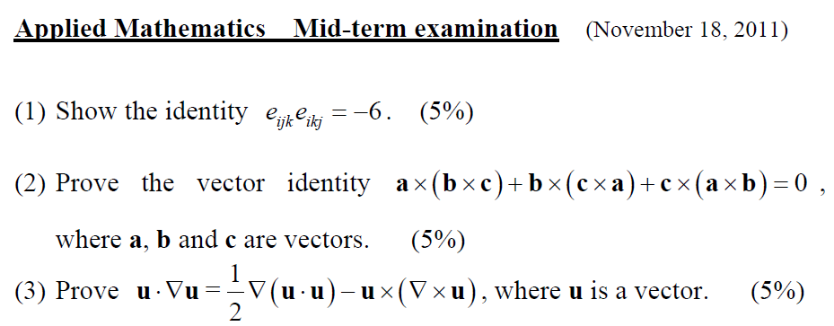

Slide 86
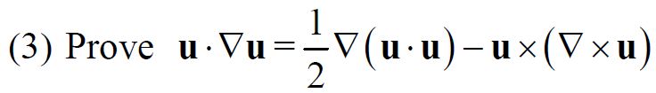

Slide 87
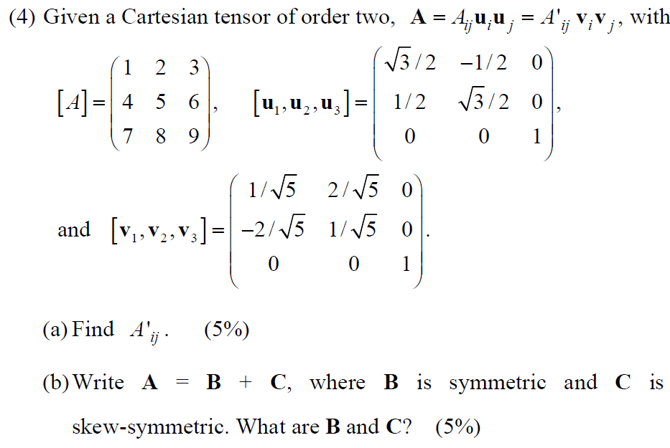

Slide 88
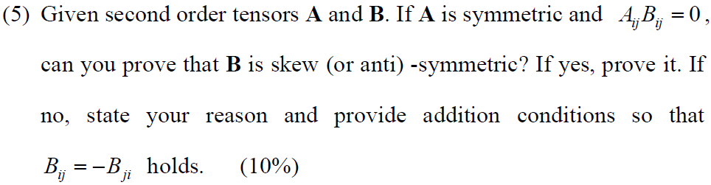
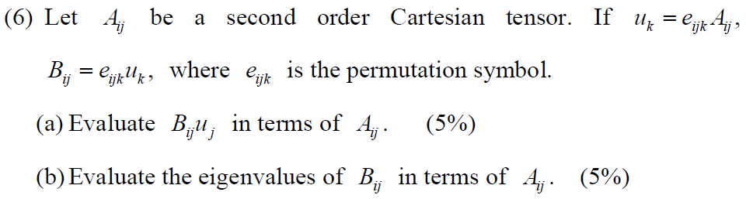

Slide 89
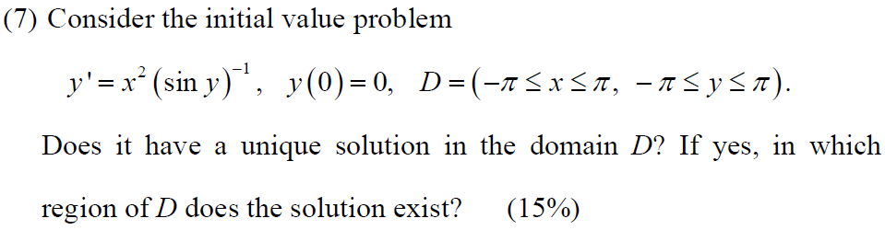

Slide 90
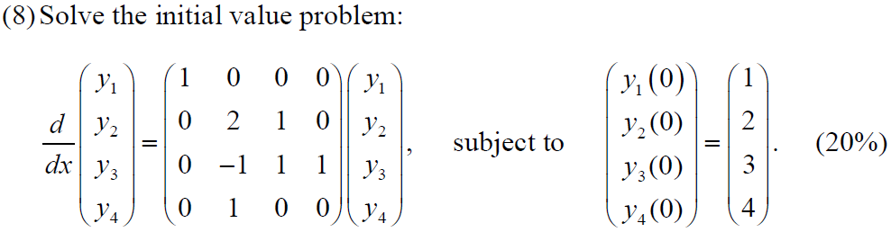

Slide 91
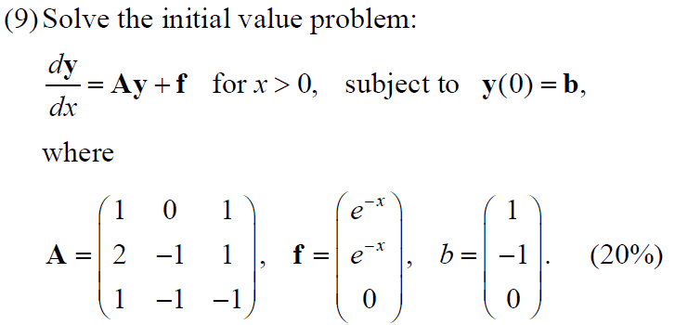

Slide 92
期中考成績資料
01 班
最高： 90
最低： 38
平均： 67.5
人數： 47人
02 班
最高：
最低：
平均： 68.2
人數： 41人
2
7
17
14
6
1
50
60
70
80
90
3
1
12
12
6
1

Slide 93
103-1 期末考成績資料
01 班
最高： 108
平均： 76.7
人數： 40人
02 班
最高： 109
平均： 70.3
人數： 32 人
2
2
11
4
14
7
50
60
70
80
90
4
4
5
10
6
3

Slide 94
Statistics of midterm scores
01 class
Highest： 100
Average： 65.4
# of students： 36
02 class
Highest ： 100
Average ： 64.5
# of students： 38

Slide 95
1.1 Linear & nonlinear 1st order PDE
，
linear PDE:
(subscript comma implies derivative)
semi-linear PDE:
where a, b are functions of x & y only, but
quasi-linear PDE:
where a, b, d are functions of
(fully) nonlinear PDE:
(other than linear, semi-linear or quasi-linear)

Slide 96
First order linear PDE & method of characteristics
Consider
where a, b and d are functions of x & y only.
define vector v as
since

Slide 97
7. Wave equation (D’Alembert’s solution)
Let
(why ??)
f & g depend on initial & boundary conditions.
(ODE vs PDE)
or
The general solution of 1-D wave equation can always be expressed as a sum of two arbitrary functions with arguments x + ct and x − ct.
Notes:
Since boundaries will introduce complications in wave propagation due to reflection phenomena. The first consideration will involve “infinitely long” rods where the problem of boundary reflection will not arise.

Slide 99
117(n)
or, take
associated Green’s function
from BC:
continuity cond.:
jump cond.:
from BC:
from continuity and jump conditions,
How to express u in terms of G?
2 eqs. for 2 unknowns B₁ & B₁

Slide 100
117(r)
associated homogeneous prob.
from BC:
Need to find adjoint homogeneous sol.
For this problem, L=L*.
For adjoint boundary condition, since
adjoint BC → adjoint homogeneous
solution

Slide 101
118
or, take
associated Green’s function
from BC:
from BC:
to satisfy continuity condition, take
from continuity and jump conditions,
jump condition
3 eq. for 3 unonowns

Slide 102
120
or, take
associated Green’s function
from BC:
from BC:
to satisfy continuity condition, take
from continuity and jump conditions,

Slide 103
124
--- (1)
from BC:
from jump condition (no continuity cond.)
associated Green’s function
--- (2)
adjoint Green’s function
--- (3)
from BC:
from jump condition (no continuity cond.)
or, take

